Slide 1
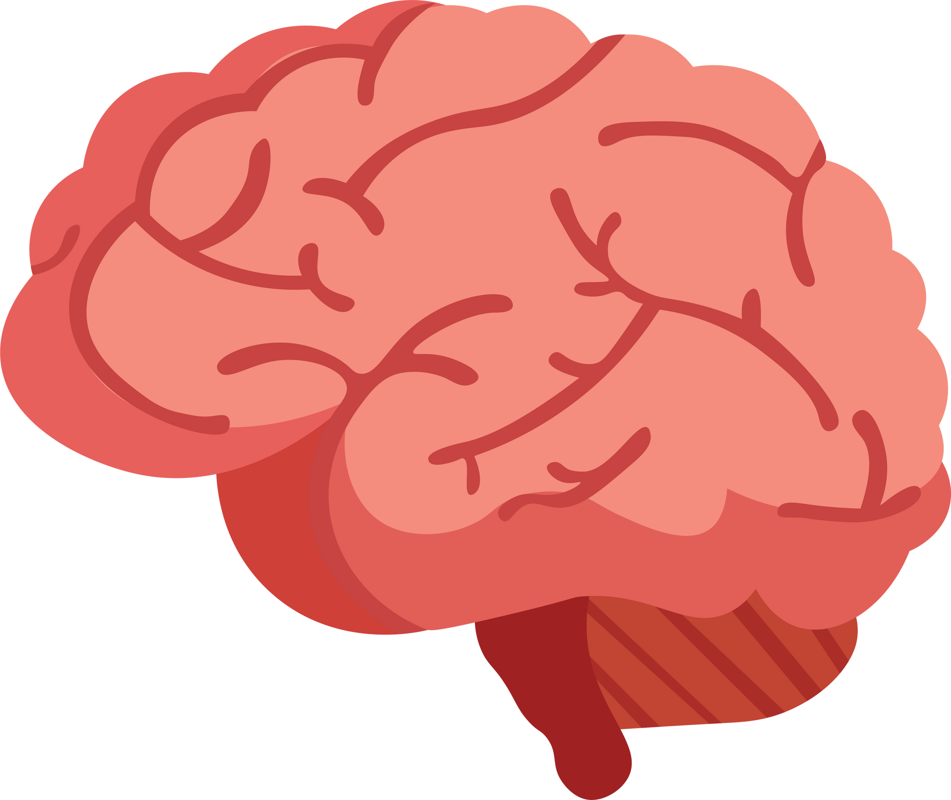

identifying Brain Tumors with Generative Sampling
Ying Zheng, Yujing Zhou, Jessica Christa Wira ​
In fulfillment for DS 540 with Dr. Shekhar

Slide 2
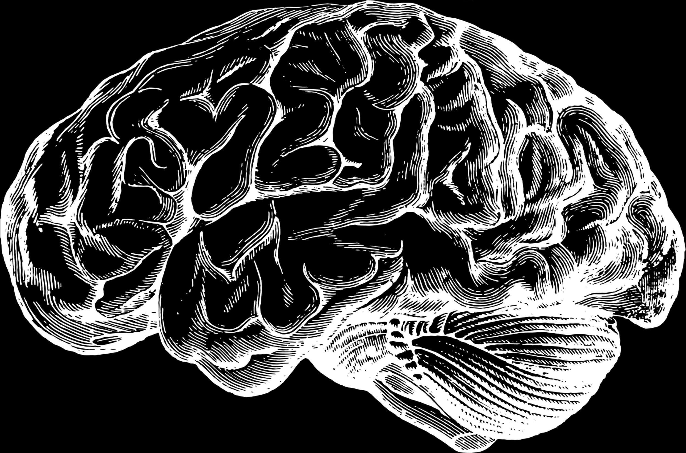
Team
Info
Jessica Christa Wira​
Junior in BS Computational Math​ / MS Data Science
Research interest: Application of machine learning methods in industries
Ying Zheng​
MS Data Science​
Received a Bachelor of Science in Computational Mathematics in Embry-Riddle​
Research interests: Recommendation engines and personalization models
Yujing Zhou​
MS Data Science​
Received Bachelor of Science degree in Aviation Maintenance Science ​
Research interests: Machine learning and data analytics on aviation safety.

Slide 3
project
goal
Generate additional brain image data for a small dataset using a variational autoencoder
Identify the image to its corresponding class
Models used
Random Forest
Support Vector Machine
Convolutional Neural Network
Compare the performance of the models with the additional generated data to the original dataset
Compare the performance of the models to each other

Slide 4
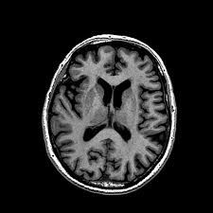
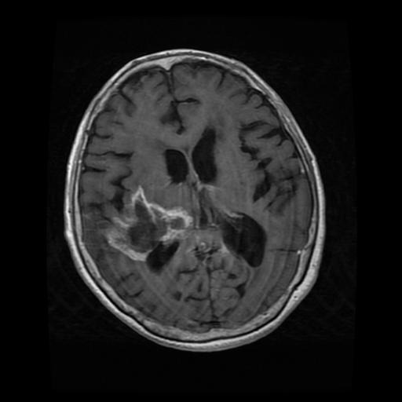
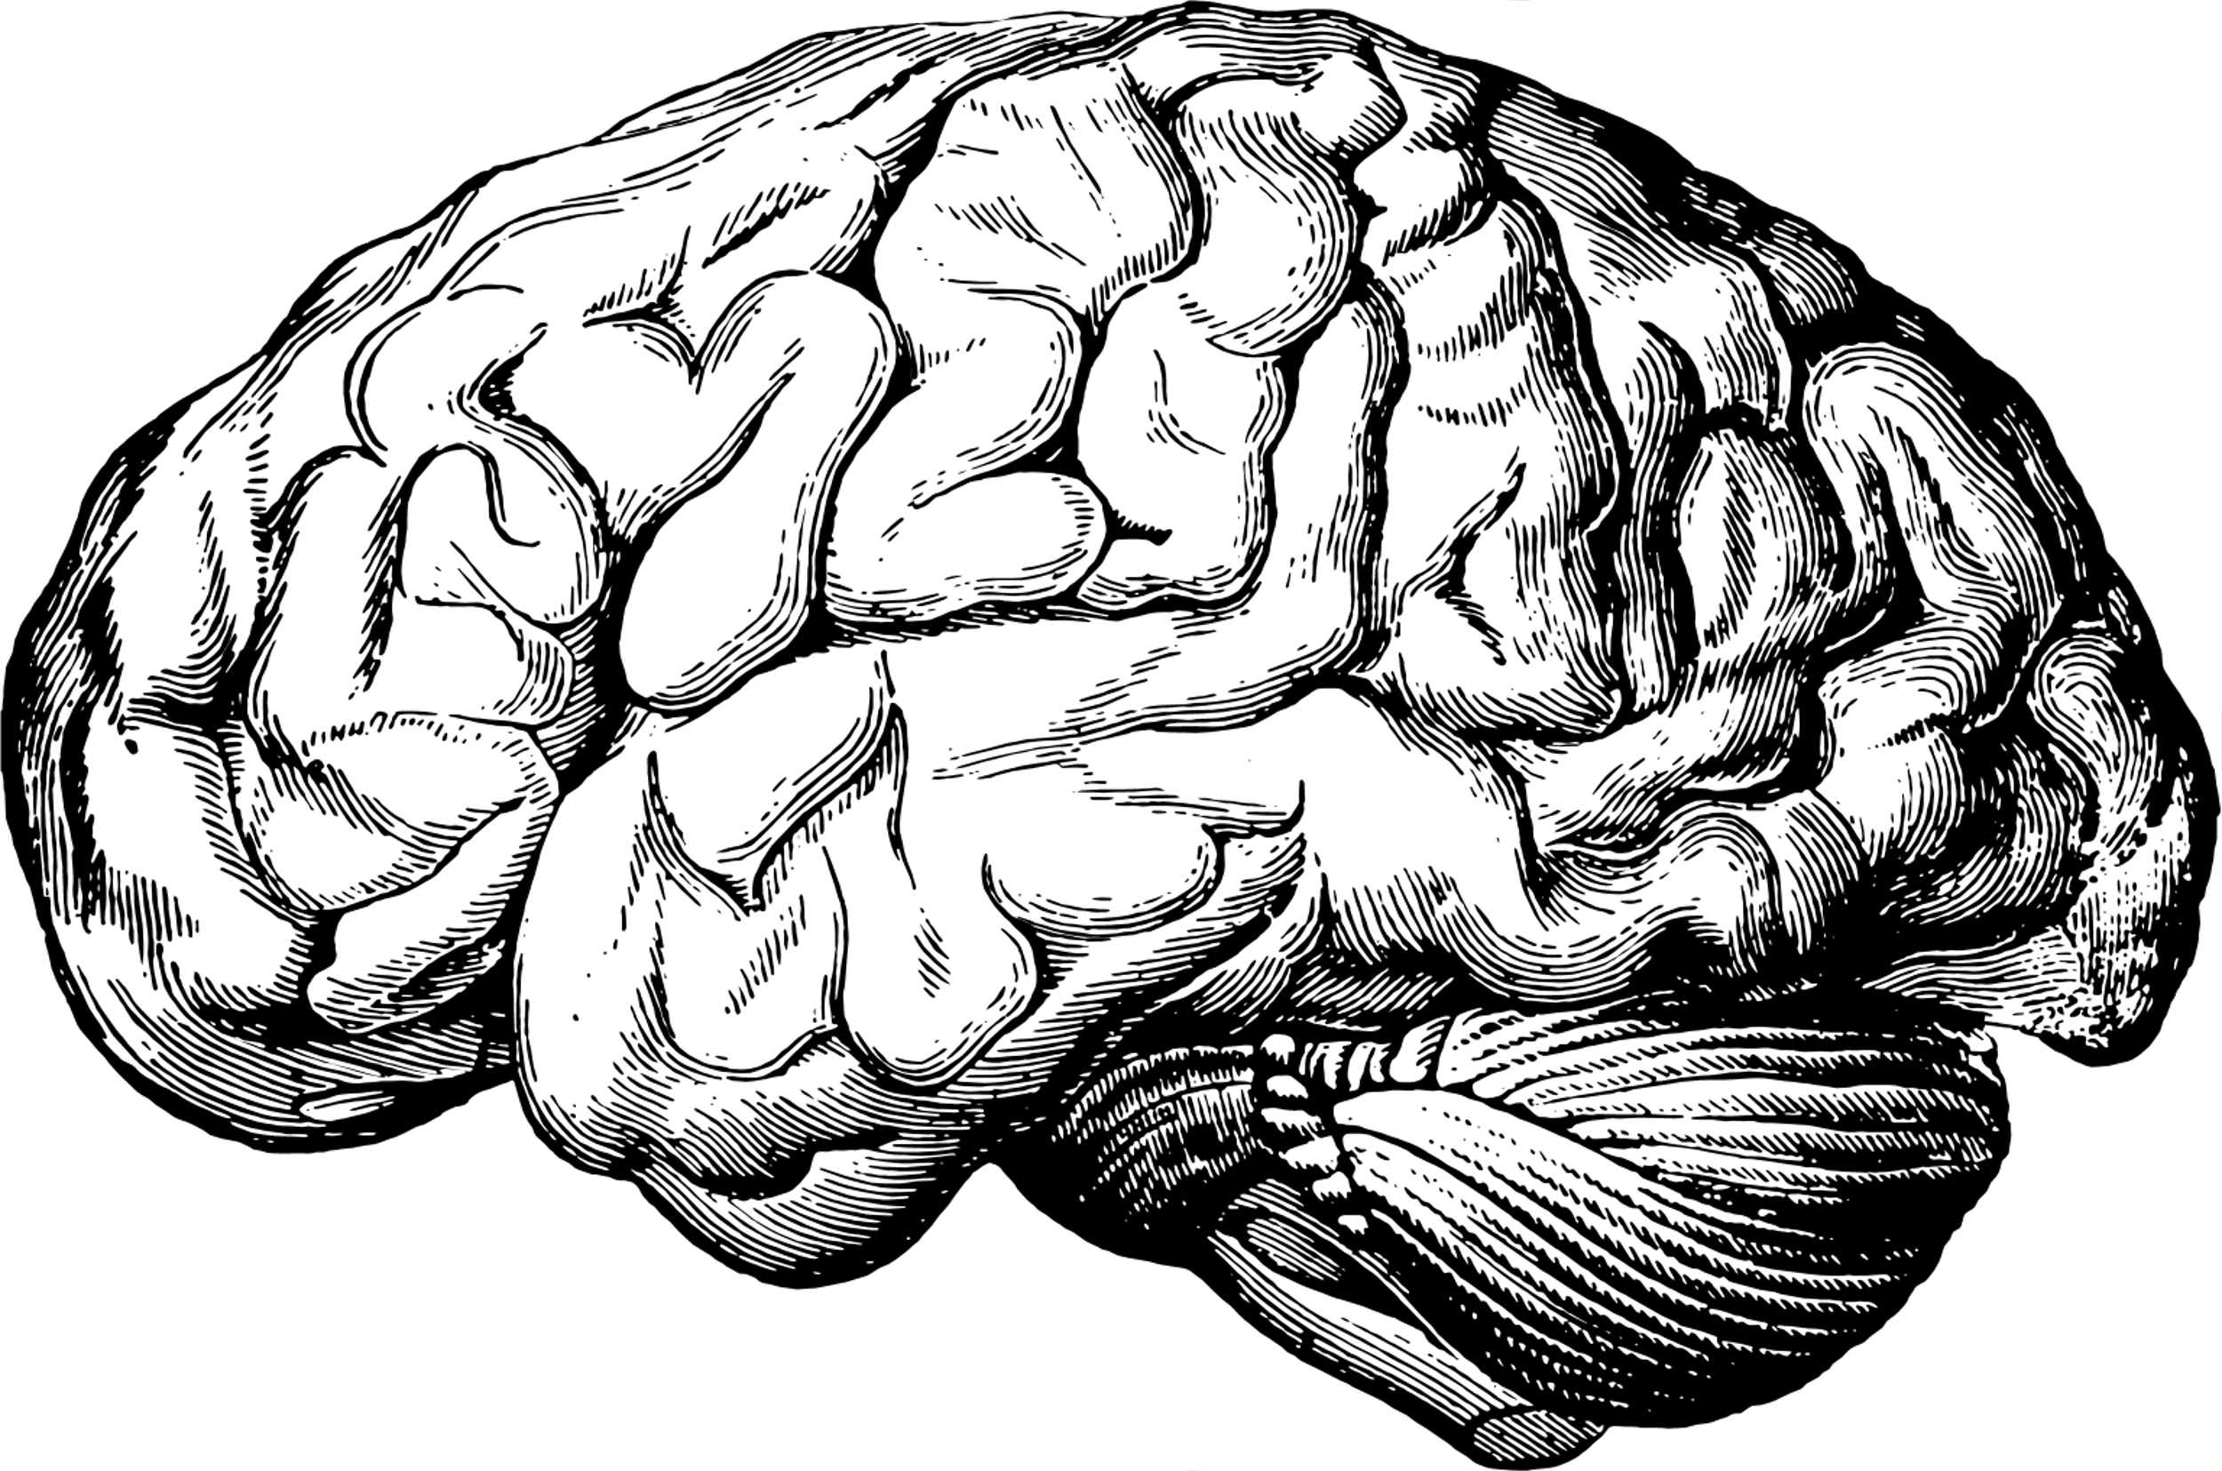
data
overview
253 x-ray scans of brain images
Training samples: 141 images
Testing samples: 76 images
Validation samples: 36 images
2 classes
Tumor (155 samples)
No tumor (98 samples)
No Tumor
Tumor

Slide 5
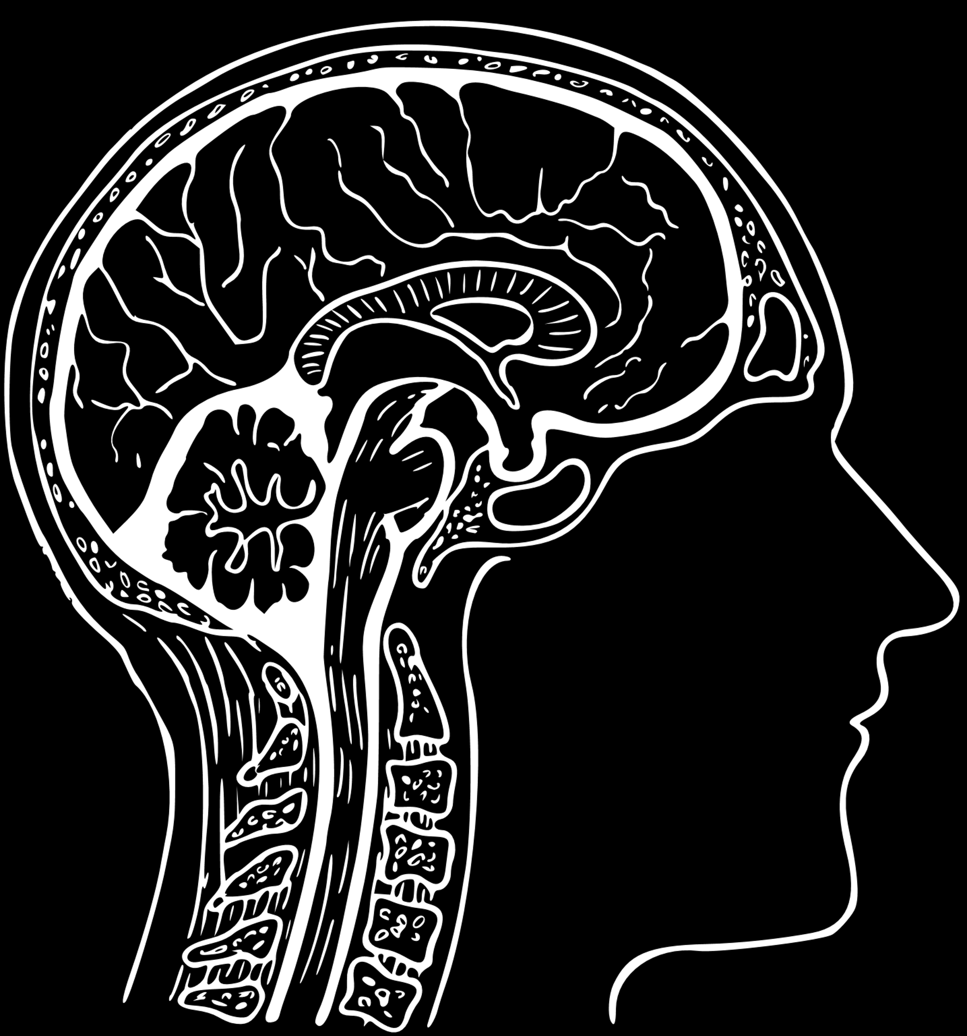
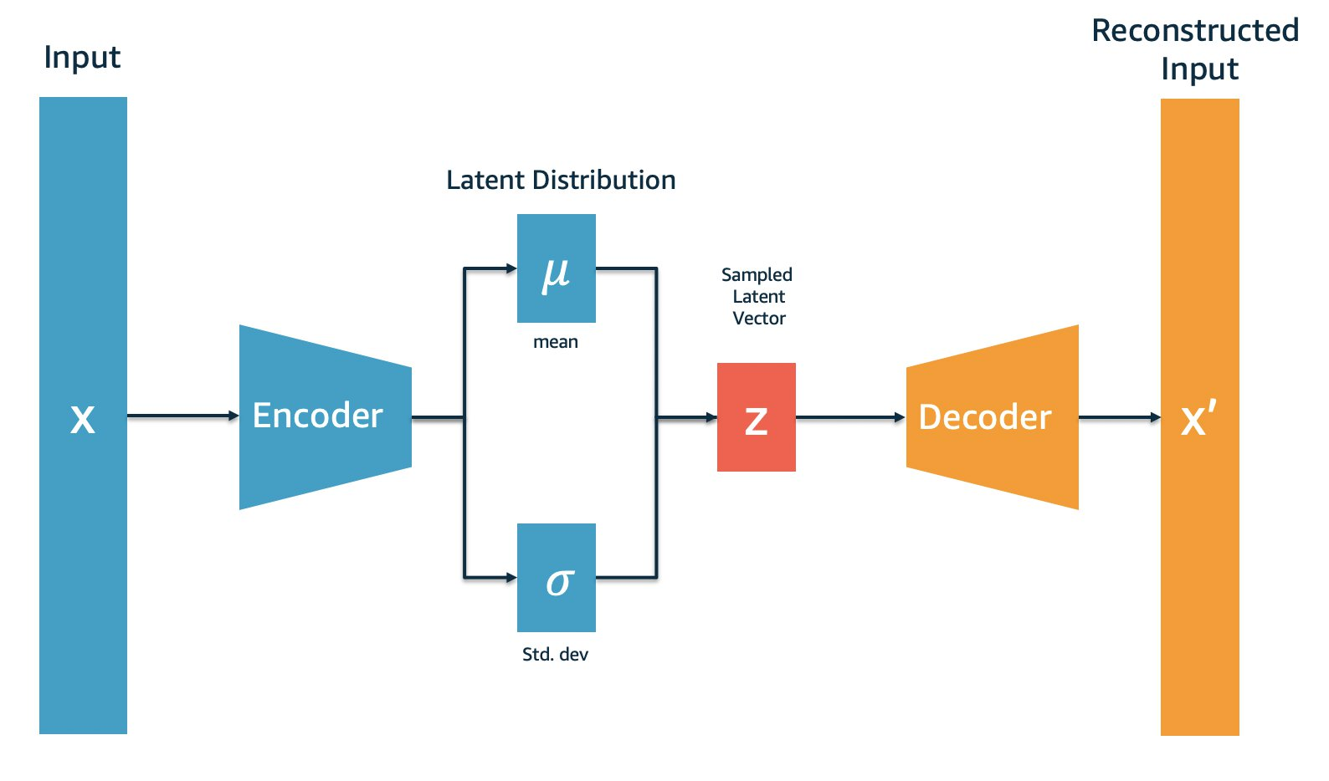
Variational Autoencoder
Generative model that uses probability distributions to create different representations of the input data
Encoder and decoder architecture
Figure 3.
Notes:
Standard autoencoders learn to generate compact representations of the input. instead of encoding an input as a single point, we encode it as a distribution (mean and variance) over the latent space
first, the input is encoded as distribution over the latent space
second, a point from the latent space is sampled from that distribution
third, the sampled point is decoded and the reconstruction error can be computed
finally, the reconstruction error is backpropagated through the network to adjust the weights for training

Slide 6
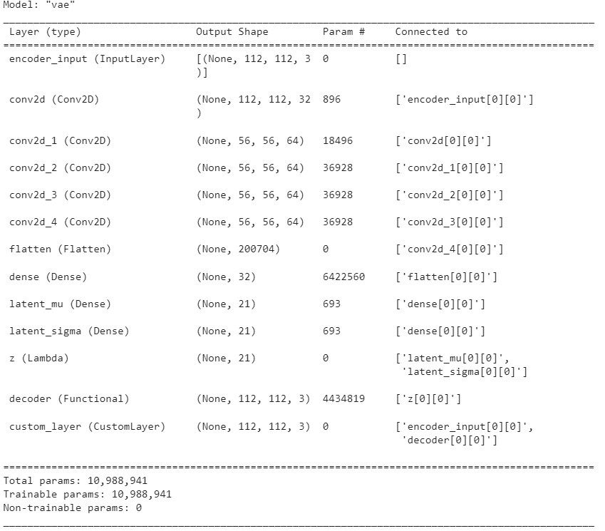
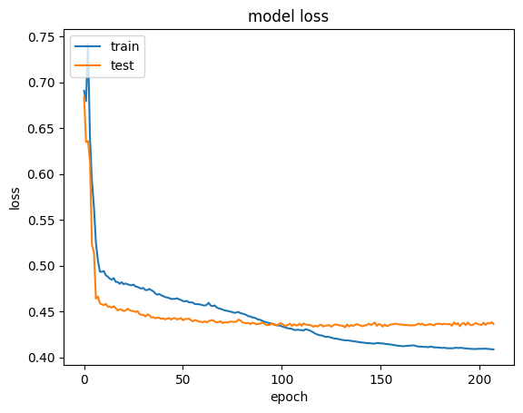
Variational Autoencoder
Notes:
Standard autoencoders learn to generate compact representations of the input. instead of encoding an input as a single point, we encode it as a distribution over the latent space
first, the input is encoded as distribution over the latent space
second, a point from the latent space is sampled from that distribution
third, the sampled point is decoded and the reconstruction error can be computed
finally, the reconstruction error is backpropagated through the network to adjust the weights for training

Slide 7
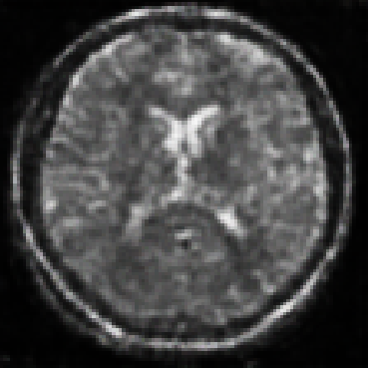
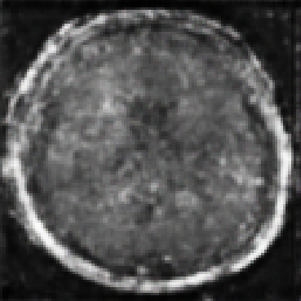
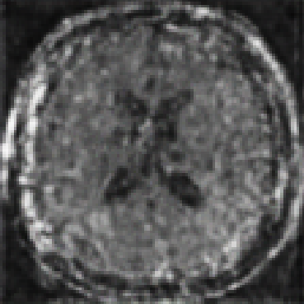
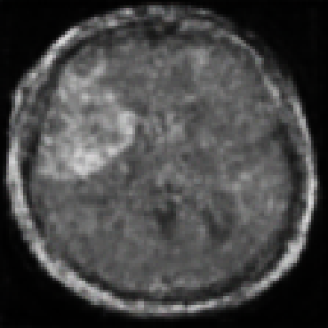
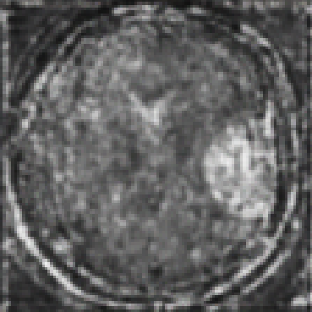
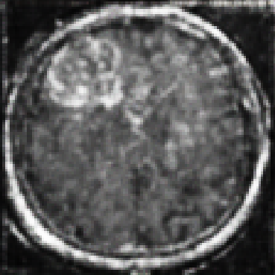
Variational Autoencoder
No Tumor
Total: 89 images generated
Tumor
Notes:
Standard autoencoders learn to generate compact representations of the input. instead of encoding an input as a single point, we encode it as a distribution over the latent space
first, the input is encoded as distribution over the latent space
second, a point from the latent space is sampled from that distribution
third, the sampled point is decoded and the reconstruction error can be computed
finally, the reconstruction error is backpropagated through the network to adjust the weights for training

Slide 8
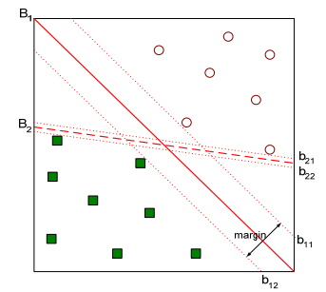
Support Vector Machine
Find a hyperplane that distinctly classifies data points
Maximize margin (the max distance between the data points of different classes)
Hyperparameters:
Kernel
Gamma
C

Slide 9
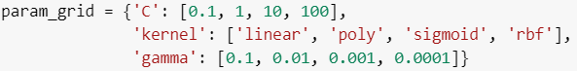
Support Vector Machine
Resized data to 112 x 112 pixels
Images flattened to be 2D array (12544 columns)
Training set = 70%
Validation set = 20% of training set (Stratified, random_state = 0)
Hyperparameter tuning (GridSearchCV)

Slide 10
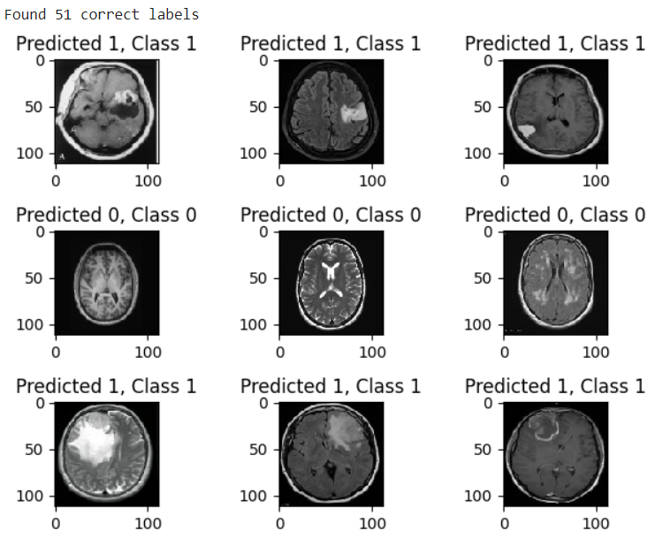
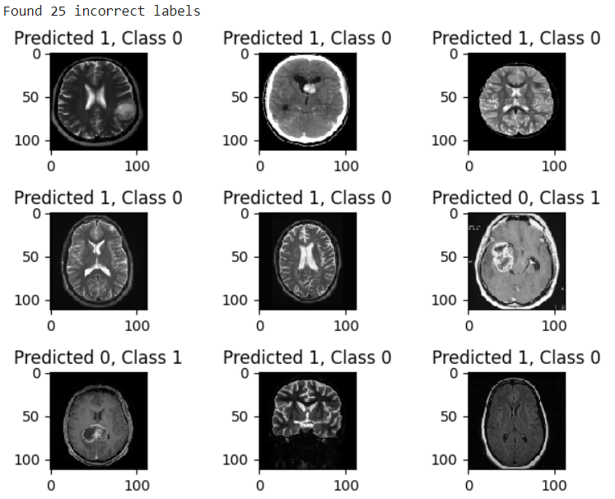
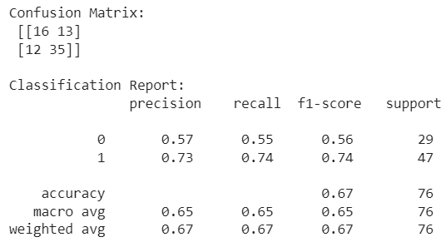
Support Vector Machine
Original Data
Training accuracy:
1.0
Test accuracy:
0.67
Sensitivity:
0.74

Slide 11
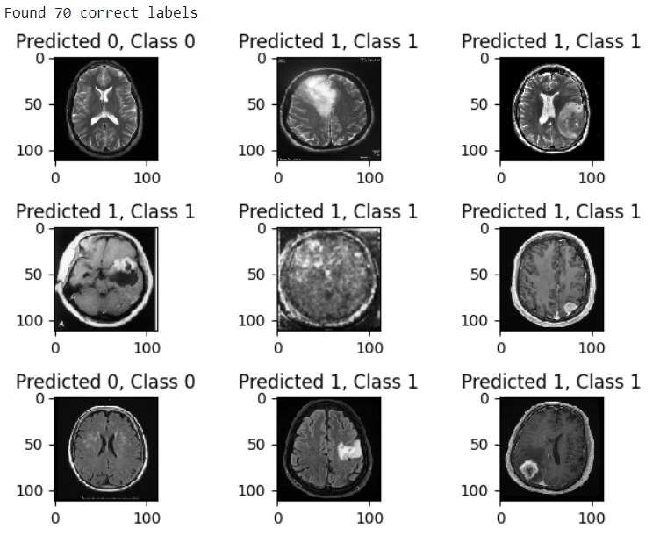
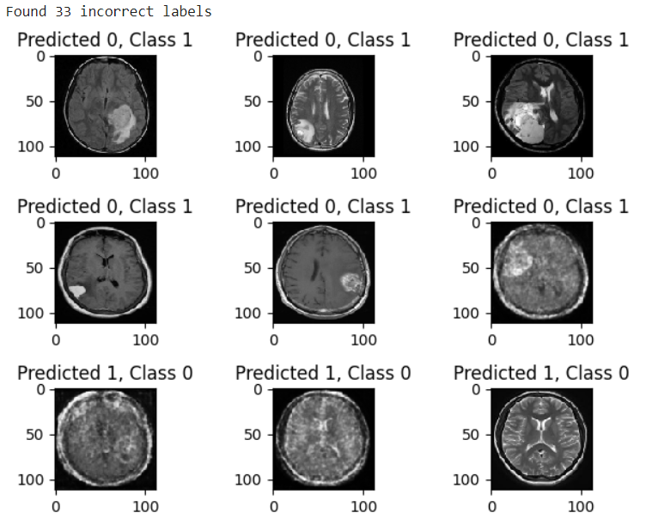
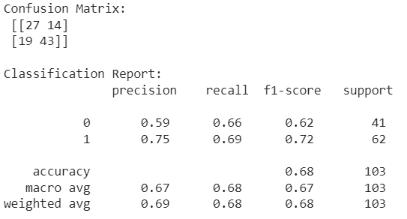
Support Vector Machine
Mixed Data
Training accuracy:
1.0
Test accuracy:
0.68
Sensitivity:
0.69

Slide 12
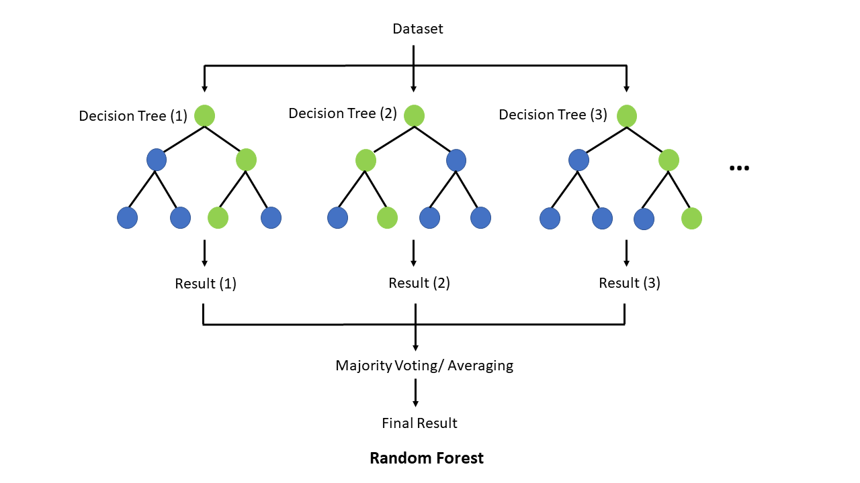
Random Forest
Ensemble methods
Using majority vote or weighted majority vote (weighted according to their accuracy or relevance)
An extension of the bagging method as it utilizes both bagging and feature randomness to create an uncorrelated forest of decision trees

Slide 13
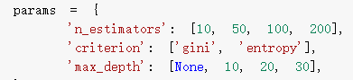
Random Forest
Resize to 112 x 112 pixels
Unlike CNN, flattened into 1D arrays to create a feature matrix is required
Allows the random forest classifier to handle the data as a tabular input
Grid Search
systematically search through a predefined set of hyperparameter
values to find the best combination
Each row in the feature matrix represents an image
141 original
Each column corresponds to a pixel value
112 x 112 = 12544 pixels

Slide 14
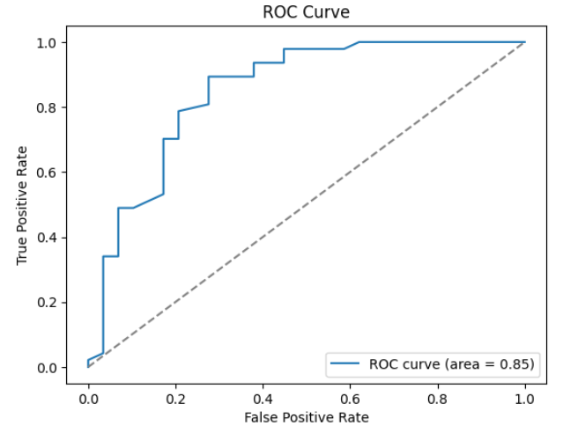
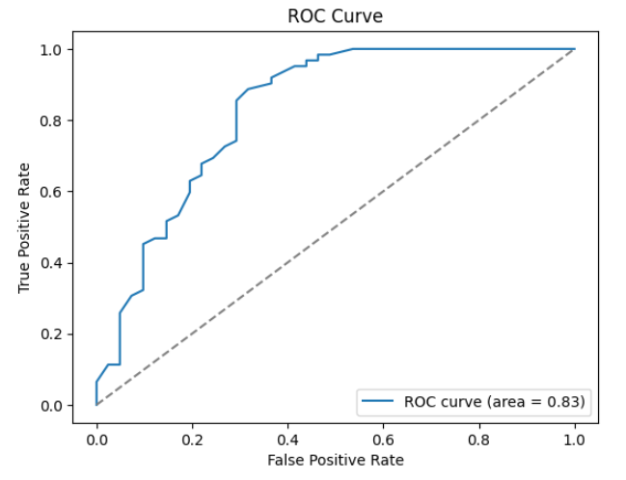
Random Forest
Original Data
Mixed Data

Slide 15
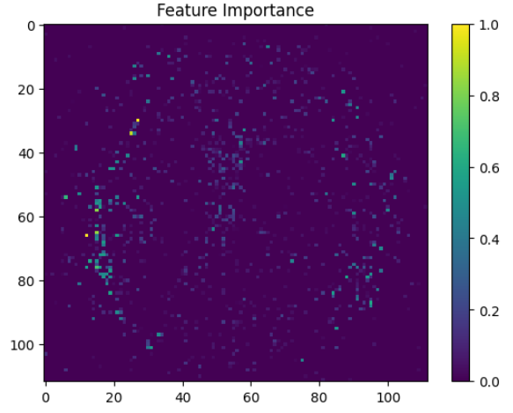
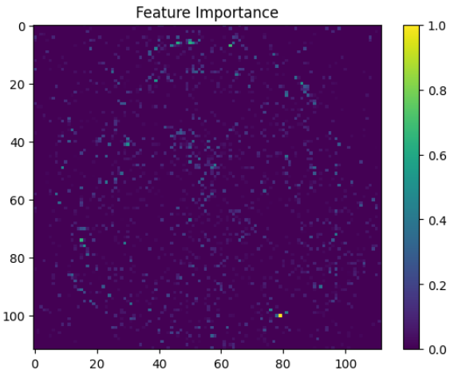
Random Forest

Slide 16
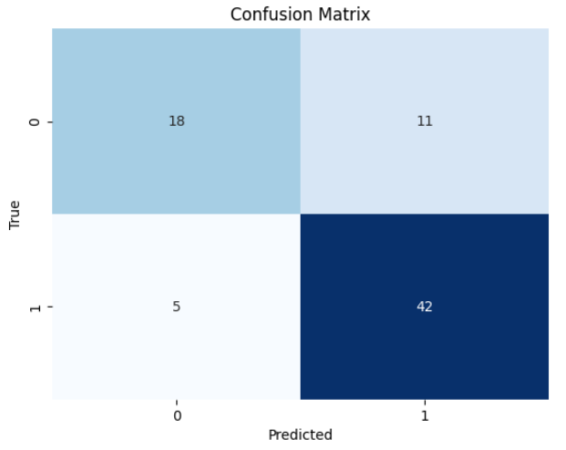
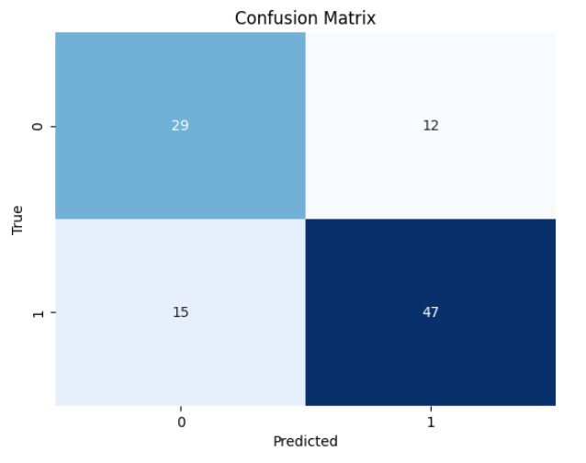
Random Forest
Original Data
Accuracy: 0.79
Sensitivity: 0.89
Mixed Data
Accuracy: 0.74
Sensitivity: 0.76
Original Data
Mixed Data

Slide 17
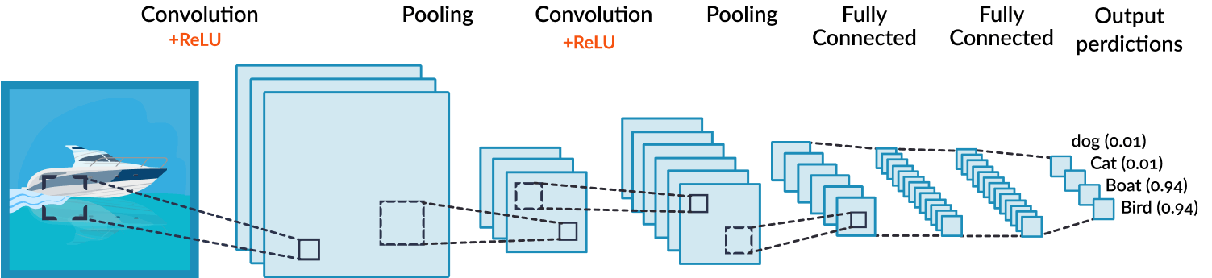
convolutional Neural Network
Convolutional layer: applies filters that have weights for image feature detection
Pooling layer: downsizes data to reduce the size of the matrix
Fully connected layer: Determines image features’ correlation to the given classes
Notes:
Computing systems that learn from data and when a user gives them an input to identify, it will output a result based on its previous training
Convolution layer: Applies filters that have values (weights/parameters) to help the machine detect features
Pooling layer: downsizes data to reduce the size of the matrix
Fully connected layer: Looks at the last convolutional layer and determines what features correlate to a particular class

Slide 18
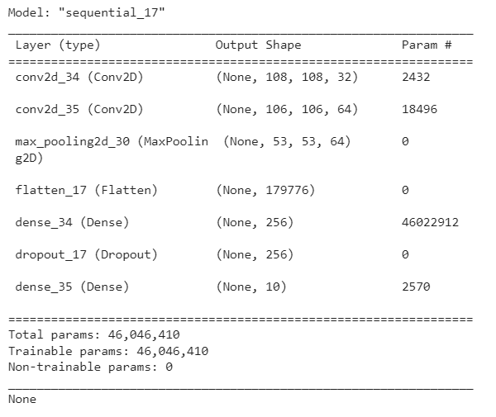
convolutional Neural Network
Optimizer: adam
Loss function: sparse categorical cross entropy
Batch size: 15
Notes:
Computing systems that learn from data and when a user gives them an input to identify, it will output a result based on its previous training
Convolution layer: Applies filters that have values (weights/parameters) to help the machine detect features
Pooling layer: downsizes data to reduce the size of the matrix
Fully connected layer: Looks at the last convolutional layer and determines what features correlate to a particular class

Slide 19
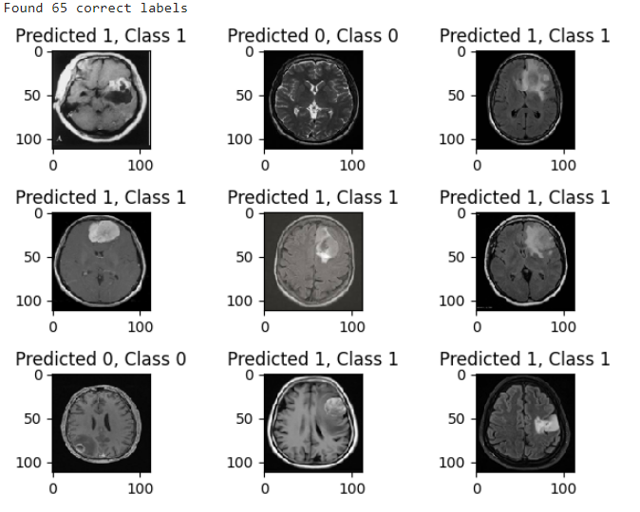
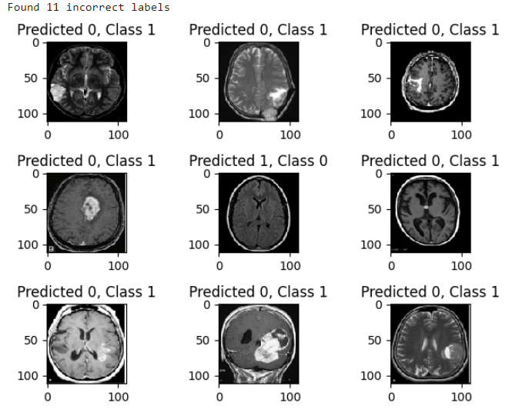
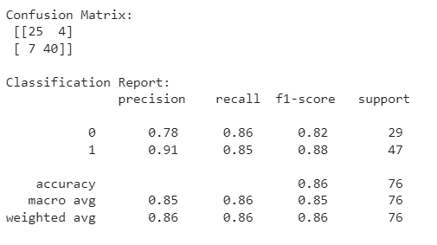
convolutional Neural Network
Original Data
Training accuracy:
.99
Test accuracy:
.85
Sensitivity
.85

Slide 20
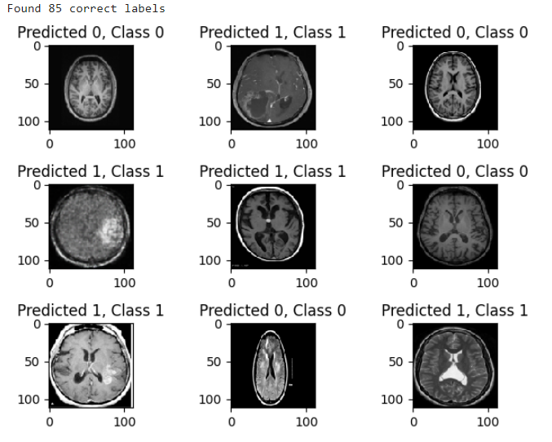
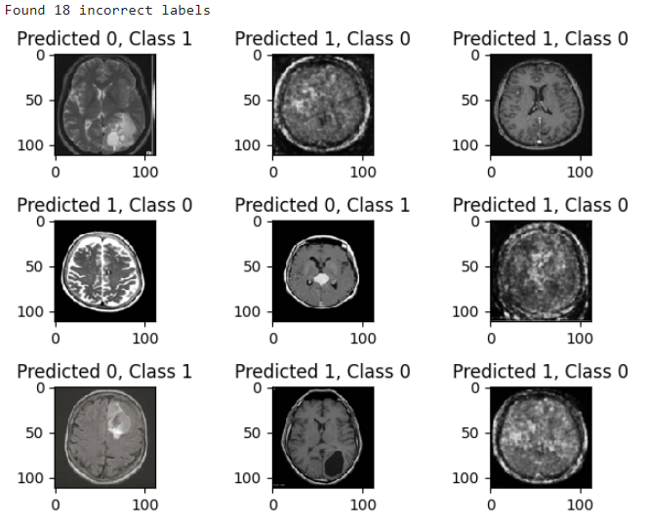
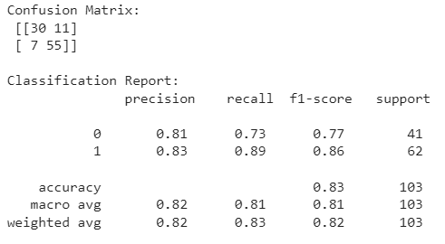
convolutional Neural Network
Mixed Data
Training accuracy:
.98
Test accuracy:
.82
Sensitivity:
.88

Slide 21
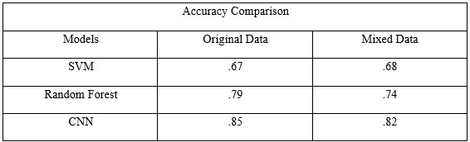
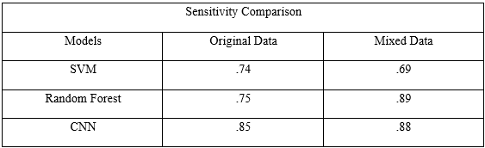
Generally, the accuracy decreases when mixed with generated data, while sensitivity increases
SVM has the lowest accuracy and sensitivity
Random Forest has the highest sensitivity for the mixed data
CNN is overall the best algorithm to classify image data
Conclusion

Slide 22
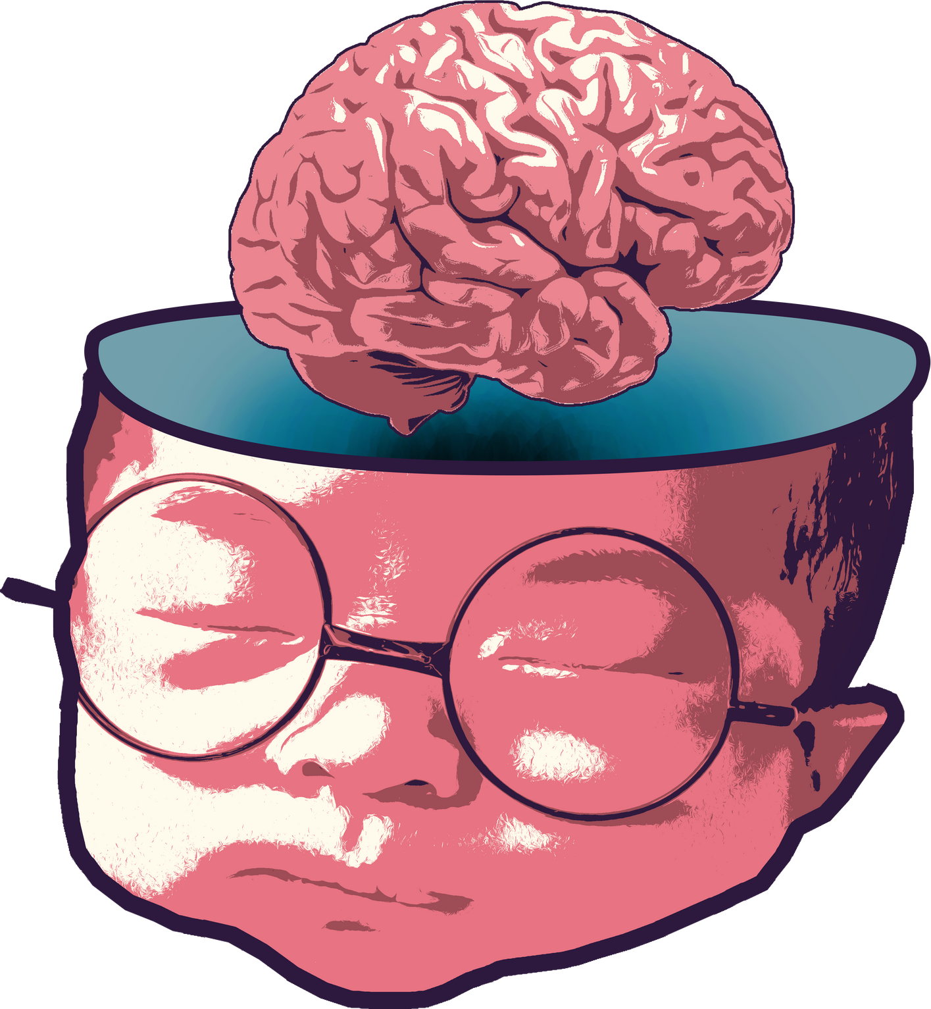
Q
uestions?

